Slide 1

ENMT 4730 SLAM Implementation
Eric Borcherding

Slide 2
Overview
Project Focus
Objectives
Equipment List
Concept
Robot Design
SLAM Implementation
Localization
Tracking
Mapping
Path Planning

Slide 3
Project Focus
Apply localization, mapping, and path planning techniques discussed in 4730 Advance Ground Robotics class.
Utilize a wirelessly controlled ground robot, vision system and python programming language.

Slide 4
Objectives
Localize ground robot in an environment utilizing computer vision
Track ground robot as it moves around an ‘obstacle’ course.
Generate a map of navigable terrain while the robot moves
Path plan to a location within the generated navigable terrain map

Slide 5

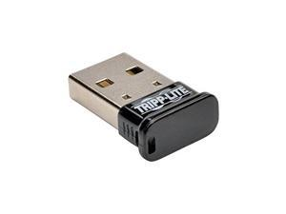
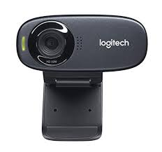



Equipment List
Hardware:
Robot: Sphero
Vision System: 720P-RGB webcam
Communication: Bluetooth Dongle
Software:
Language: Python
Vision Toolkit: OpenCV
Analysis Toolkit: Scikit Learn

Slide 6
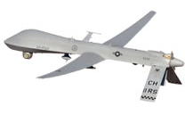
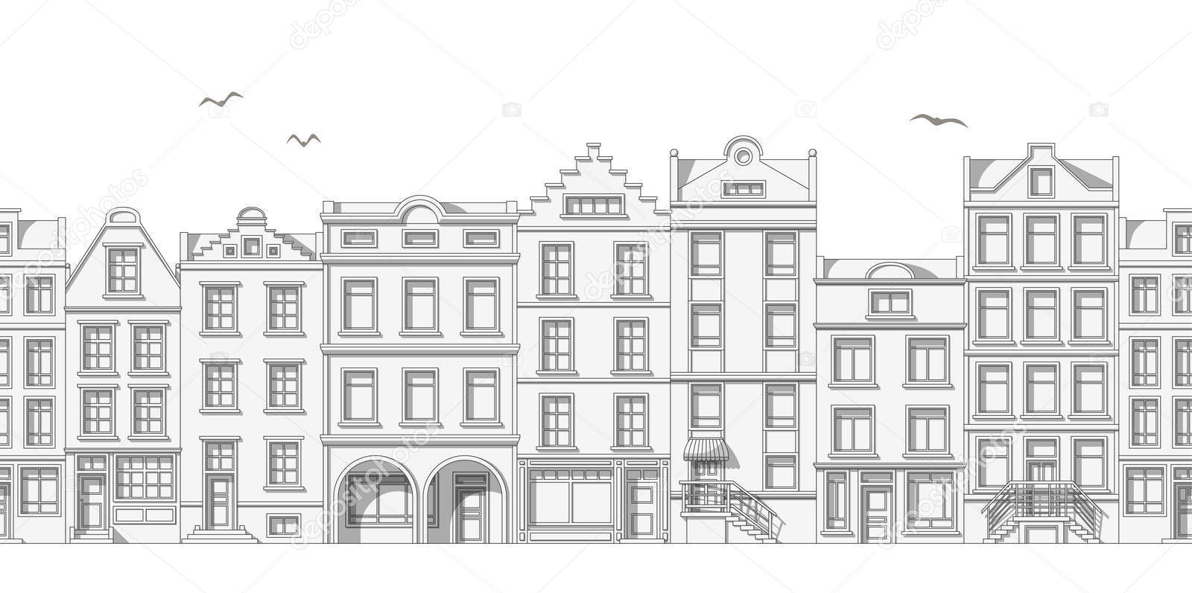

Concept
Low cost ground robot
High value overhead processing planning drone

Slide 7
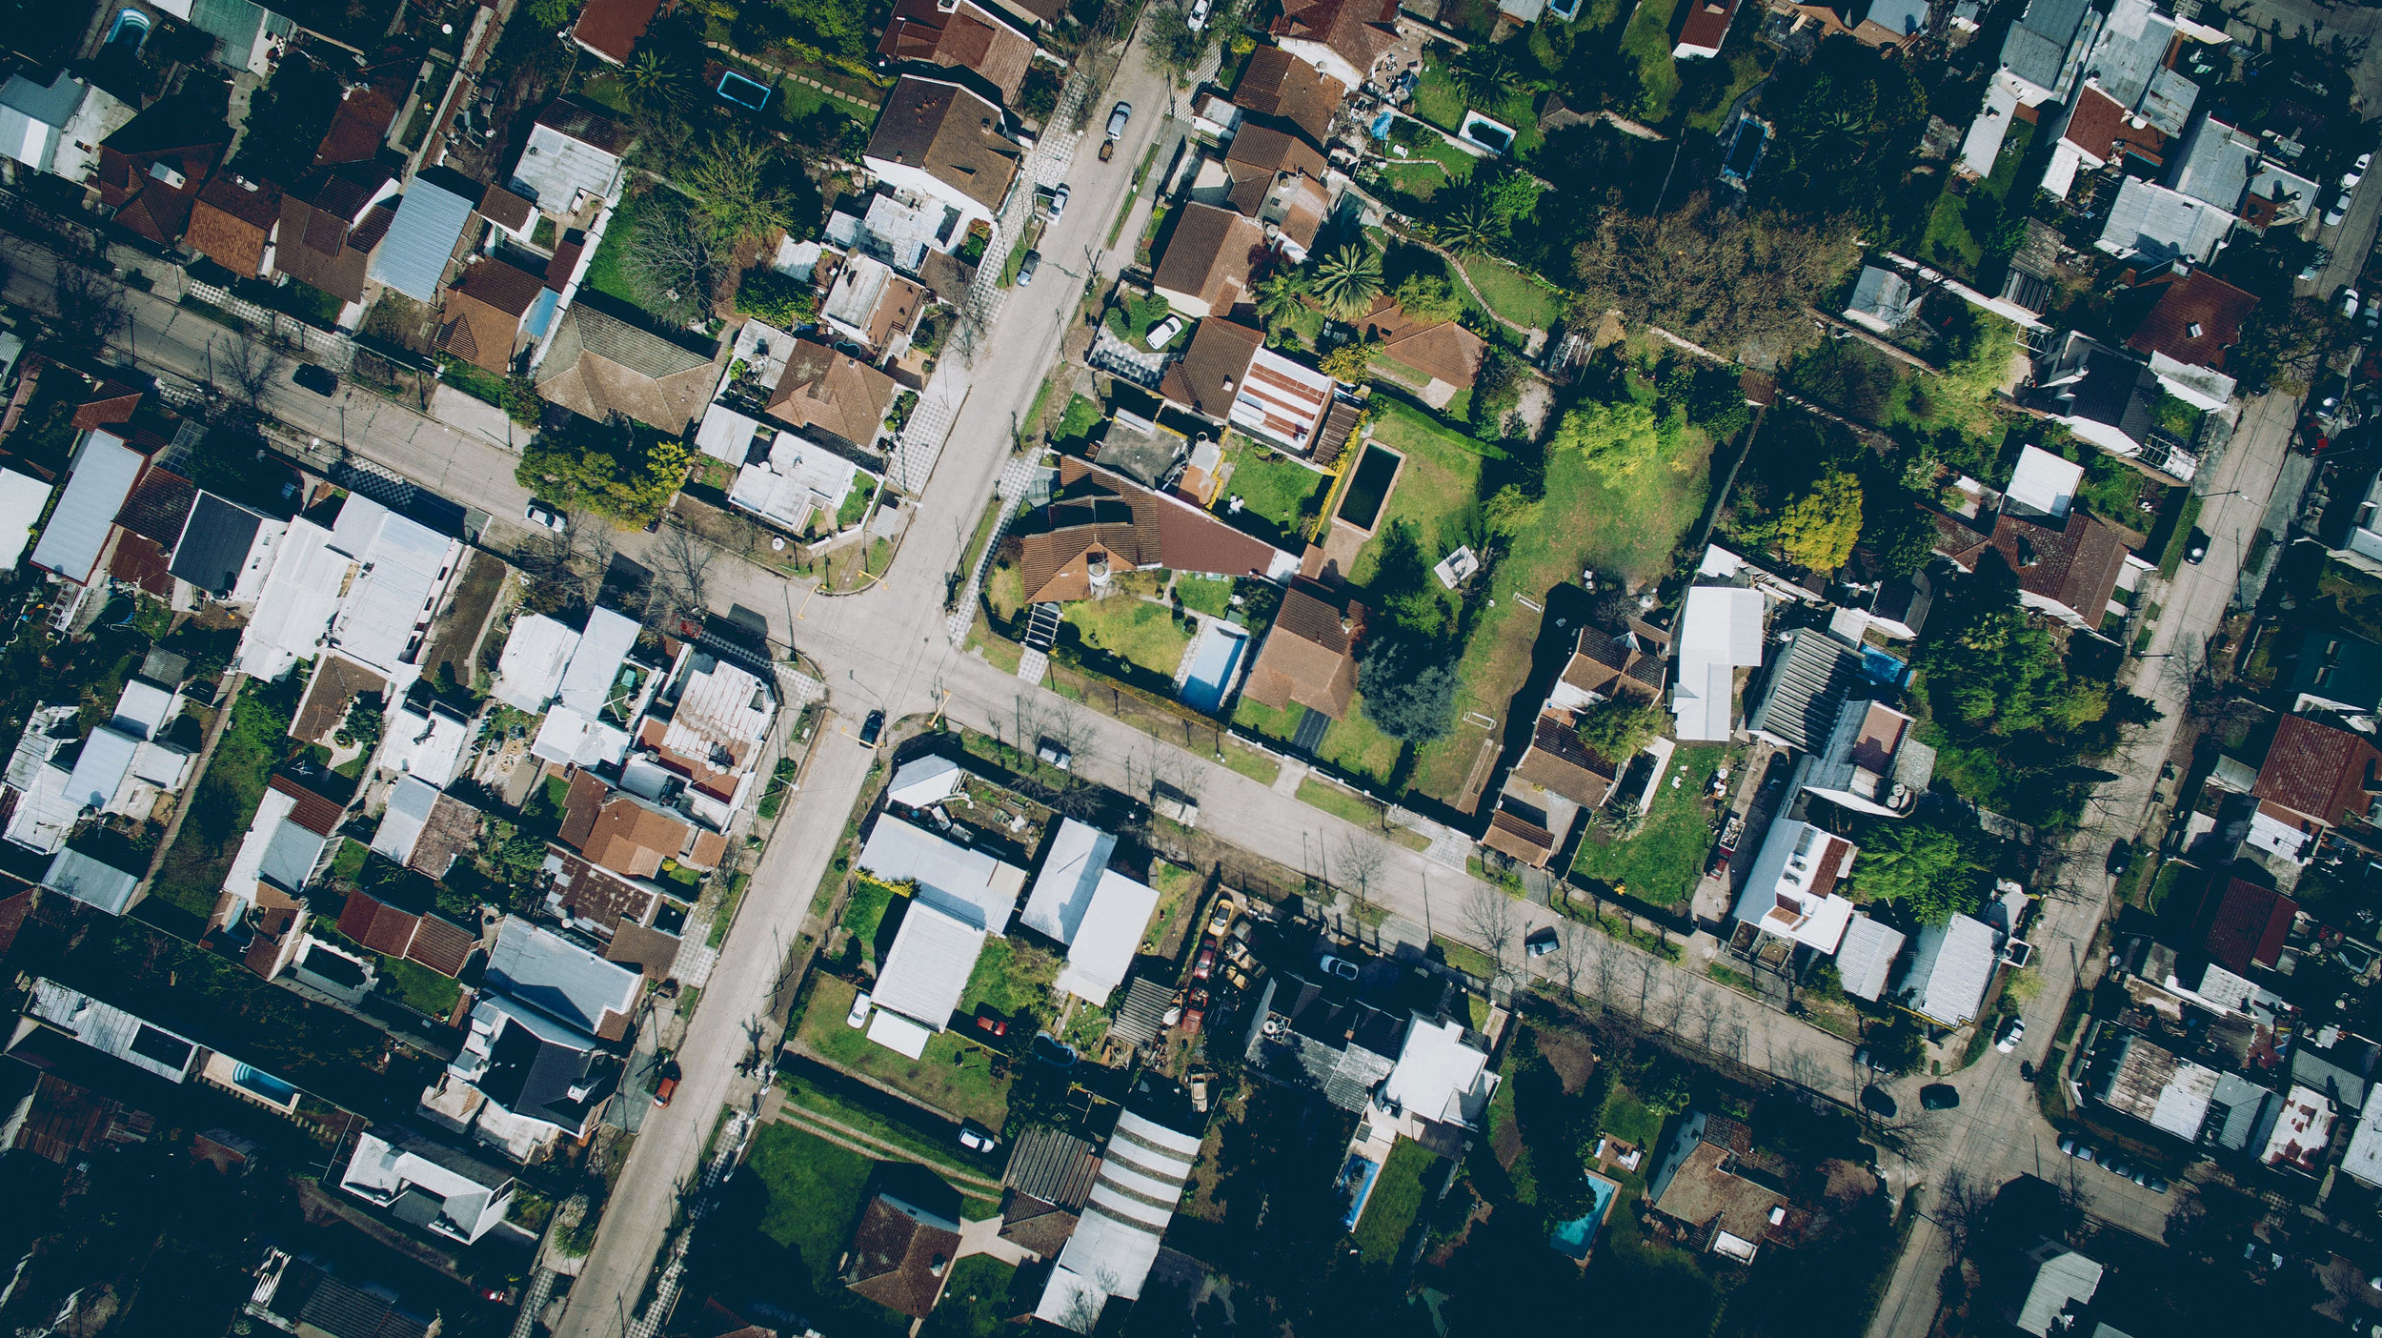



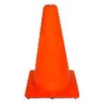
Concept

Slide 8



Robot Design
Sphero:
Holonomic robot
Manipulates internal mass to steer, accelerate and decelerate
Two independent motors used to move mass in sphere
Motors drive same direction: Mass is raised allowing Sphero to roll forwards

Slide 9

Robot Design
Sphero:
Holonomic robot
Manipulates internal mass to steer, accelerate and decelerate
Two independent motors used to move mass in sphere
Motors drive same direction: Mass is raised allowing Sphero to roll forwards
Sphero stops by returning mass to position of lowest potential energy
Motors counter rotate: Mass rotates inside shell, causing Sphero to change direction of rotation

Slide 10
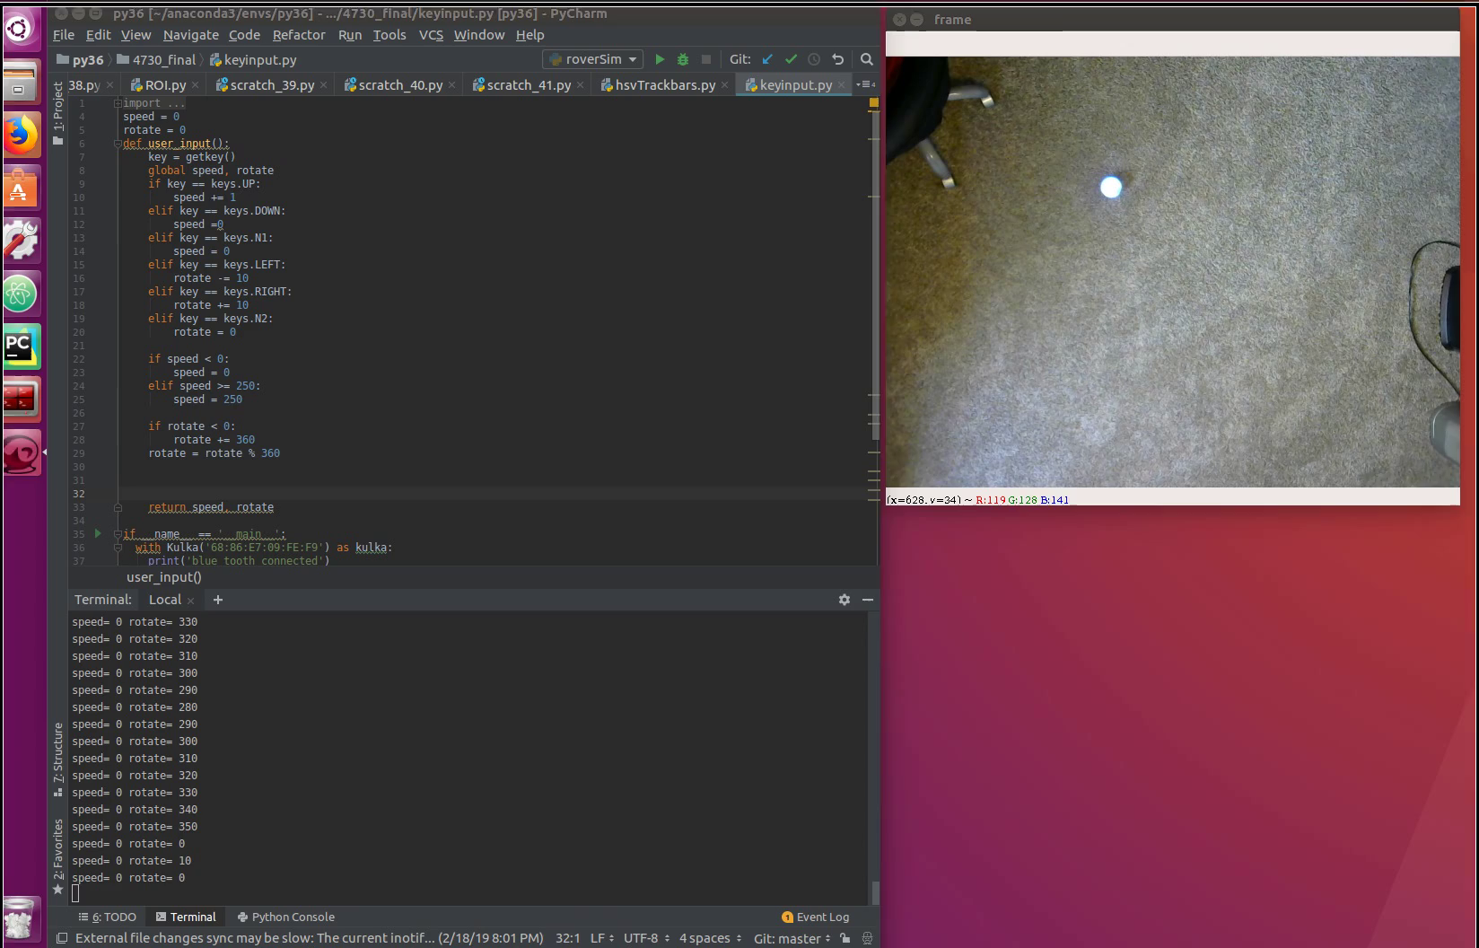
Robot Design – Sphero Control

Slide 11

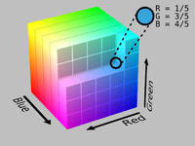
Localization
Multi-Step Localization:
HSV (Hue, Saturation, Value) Filter
HSV separates image intensity from color information
Commonly used in computer vision because of robustness to changing light conditions
Hough Circle Transform
Detects outer diameter of robot
Returns position of robot within reference frame
This position is used to initialize tracking algorithm
HSV Color Wheel
RGB Color Cube
Pictures: https://en.wikipedia.org/wiki/HSL_and_HSV

Slide 12
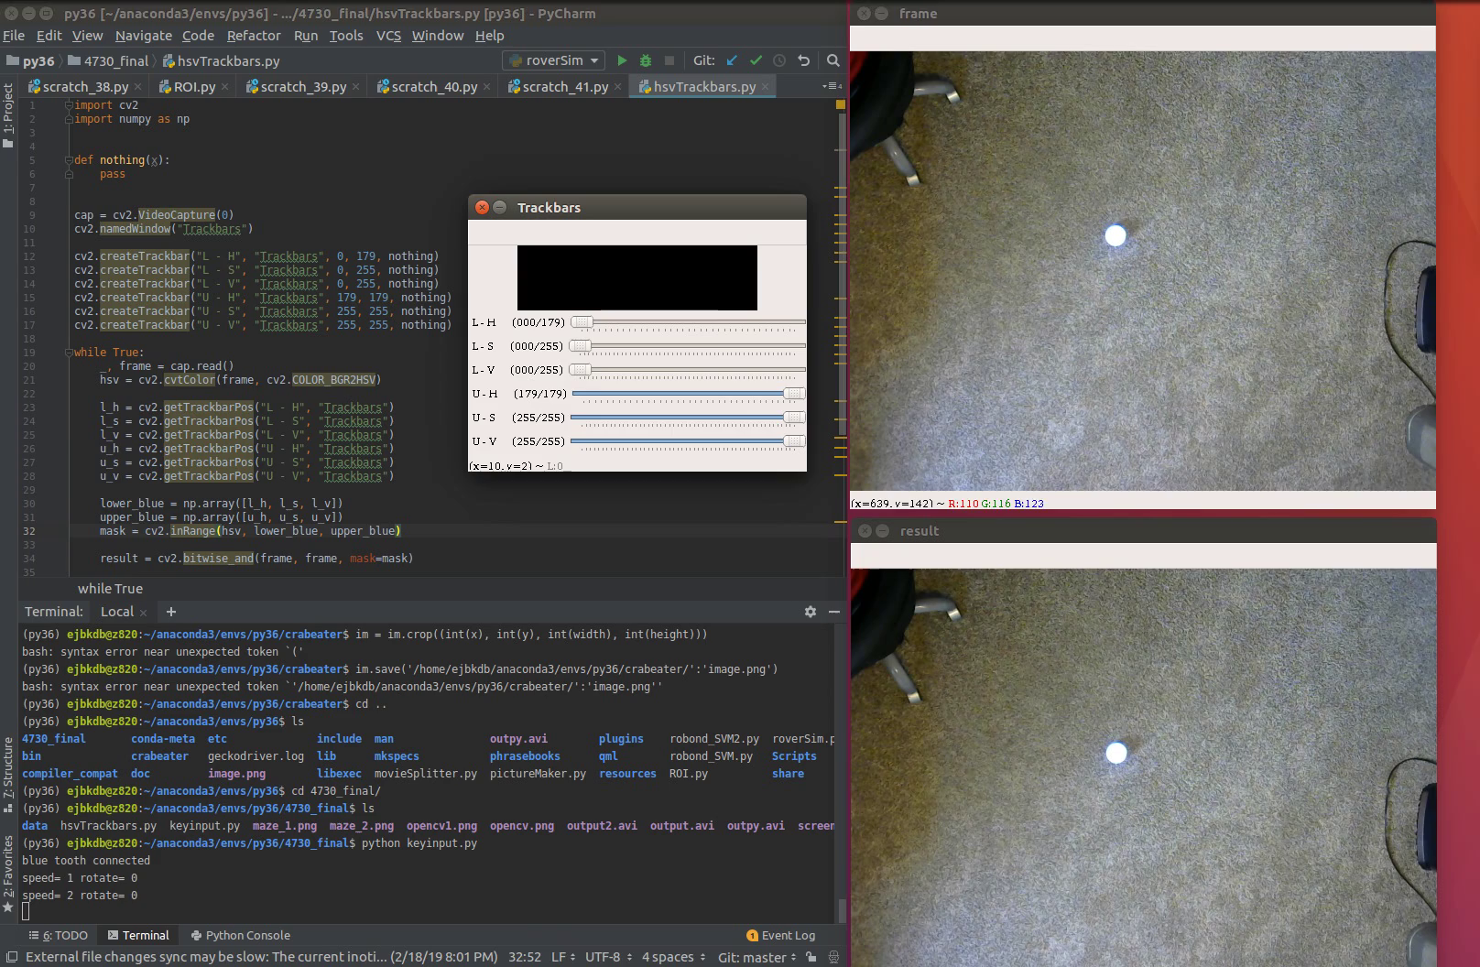
Localization - HSV Filter

Slide 13

Localization - Hough Transform

Slide 14
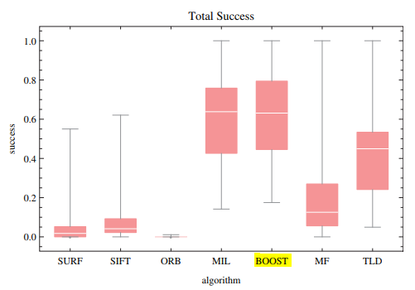
Tracking
Tracking Goals:
Implement algorithm that tracks position of Sphero as it travels around the course. Needs to return robot position
BOOSTING Tracker
Identify area of interest (utilize Localization data)
Tracker generates reference image/features.
Scans video frames to identify reference image, updates location of object being tracked.
Utilizes data from previous frames to predict how wide an area it must search to identify object of interest
Determines based on probability where the object is in new field of interest
Chart: https://www.researchgate.net/publication/309367280_Comparison_of_tracking_algorithms_implemented_in_OpenCV

Slide 15
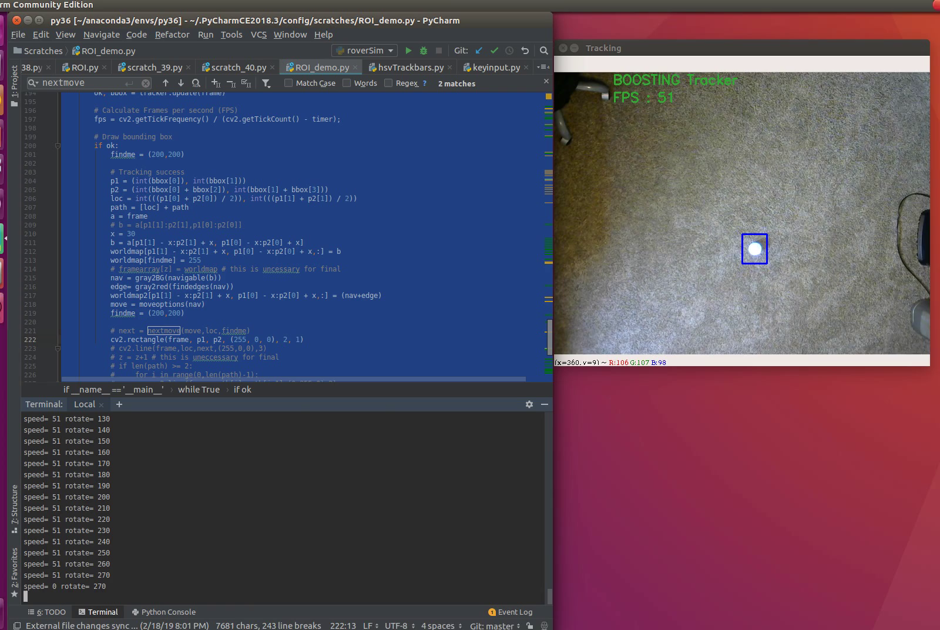
Tracking

Slide 16
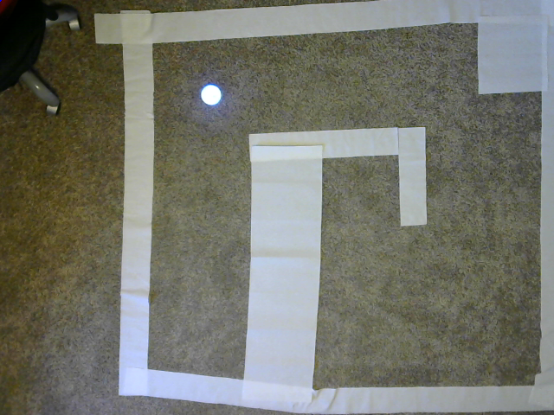
Mapping
Enviroment:
Developed a course for the Sphero to navigate through
Mapping Goals: Map course as Sphero travels though it. Output navigable terrain so future missions can utilize path planning.

Slide 17
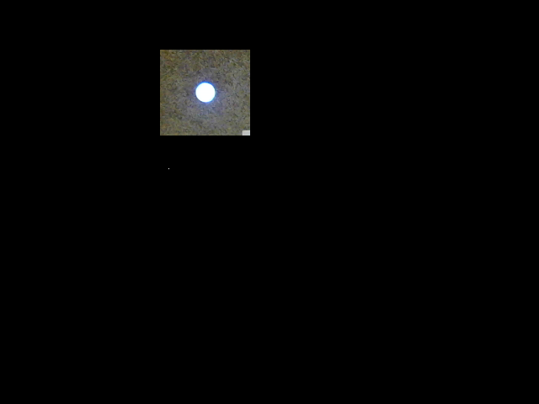

Mapping
Drone View:
Reduced viewable area to simulate drone following overhead
Implented HSV filter to determine navigable vs. non-navigable terrain.
Utilized edge detection to identify walls
Full World View
Drone View
Navigable Map

Slide 18
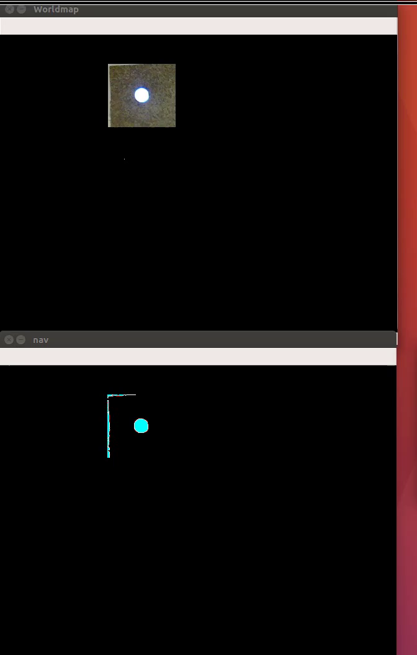
Mapping

Slide 19

Mapping - Results

Slide 20
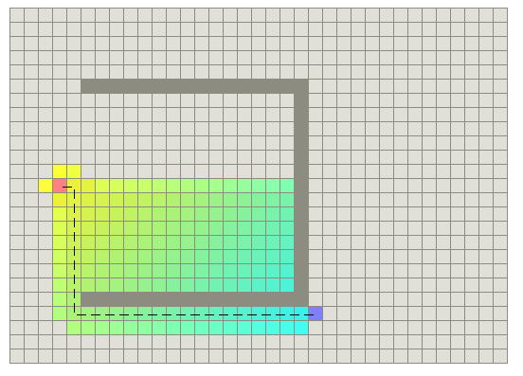

Path Planning
A* Path Planning
Goal based path planning algorithm. Determines direction of lowest cost (‘distance’). Generates path through navigable terrain
Navigable Map, with end goal (star)
A* Example
Picture: http://theory.stanford.edu/~amitp/GameProgramming/AStarComparison.html

Slide 21
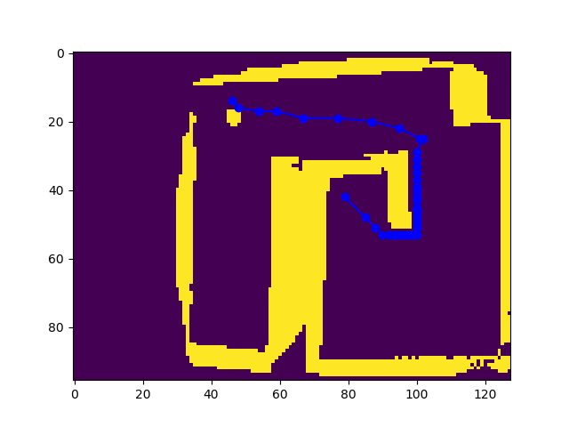
Path Planning
A* Path Planning
Goal based path planning algorithm. Determines direction of lowest cost (‘distance’). Generates path through navigable terrain
Navigable Map, with end goal (star)
A* results (blue line)

Slide 22
Conclusion
Implemented and demonstrated several techniques used in Ground Robotics, including:
Localization
HSV Filter
Hough Circle Transform
Tracking Algorithm implementation
Mapping
HSV Filter
Mapped Navigable/Non-Navigable terrain
Utilized Canny Edge detection to identify walls
Path Planning
Developed A* path planning algorithm

Slide 23


Questions

